Slide 1


Test Strategy Design/Best Practices
Wizeline

Slide 2
Table of Contents
Introduction
Test Strategy vs Test Plan
Test Strategy Types
Best Practices
Components of Test Strategy
Study Case (Example)
Group Exercise

Slide 3
Introduction
“A test strategy is not a document. A test strategy is a set of ideas that guide your testing choices. As with any set of ideas, a test strategy can be formalized and expressed in a document; encapsulated and summarized to fit any page length, down to a single page.”
Michael Bolton
Notes:
Speakers: Ivan + Enrique + Coque

Slide 4
Design
Test Plan
Test Strategy
A test plan for software project can be defined as a document that defines the scope, objective, approach and emphasis on a software testing effort
Test strategy is a set of guidelines that explains test design and determines how testing needs to be done
Components of Test plan include- Test plan id, features to be tested, test techniques, testing tasks, features pass or fail criteria, test deliverables, responsibilities, and schedule, etc.
Components of Test strategy includes- objectives and scope, documentation formats, test processes, team reporting structure, client communication strategy, etc.
Test planning is done to determine possible issues and dependencies in order to identify the risks.
It is a long-term plan of action.You can abstract information that is not project specific and put it into test approach
Test plan can change
Test strategy cannot be changed
It is defined at project level
It is set at organization level and can be used by multiple projects

Slide 5
Test Strategy Types
Methodical
Process- Oriented
Software Testing Strategies
Analytic
Dynamic
Notes:
Philosophical - removed
Analytic - based on data
Model bases - removed

Slide 6
QA Best Practices
These are some of the most important best practices that the entire QA team has learned along the working life on wizeline:
During Design
During day to day
Before start, learn to listen to your client and your team.
Cover only what adds value.
Automate the Boring Stuff.
Don't repeat yourself.
Adapt your tools to development requirements not the other way around.
Create a Test Rail Project from the beginning.
Be flexible, we are agile engineers.
Don't forget to make a Health Check plan.
Don't catch bugs until QA environment, catch them in the daily standups.
Get more involved in the code.
Get more involved in the business logic.
Learn to prioritize task when there are many battle fronts.
Learn to think in money terms.
Give feedback to your team constantly.
Don't be a wall, be a bridge to allow your team move faster and secure.

Slide 7
QA Best Practices
Technical Stuff
During BackEnd
During FrontEnd
Create flows like you do it in front end.
Think POISED:
Parameters
Outputs
Interoperability
Security
Errors
Data
Involve developers within your code.
Ask your developers to add tags to every element that would be actionable.
Start making End to End tests before Component tests.
Try to use a DSL in your test runner.
Involve developers within your code, sometimes could be a good approach involving developers with the PRs you created.

Slide 8
Components of Test Strategy
Architecture Analysis
Test Types
Unit tests
API Test
UI Test
Test Cycles
Smoke testing.
Sanity testing.
Regression.
Execution Cadence
Per Commit.
Nightly.
Every {x} hours/minutes, etc
Test Environments
Local.
Dev.
Pre-Prod (Stage).
Production.
Branching Strategy
GitFlow
Trunk based

Slide 9
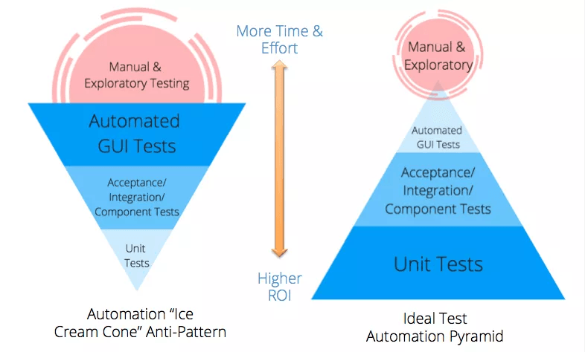
Automation Pyramid

Slide 10
Study Case (PopflyXP)
Overview: Develop a social-media mobile app for the MLB (Major League Baseball) players, so they could have a platform to create their own branding and get income for merchandise sold and exclusive content posted in the app
Technologies:
CMS
Mobile App
CMS REST API
AWS AppSync GraphQL (Mobile)
APIs
Front-end CMS development from scratch using React and headless-CMS solution “Ghost”
Okta-Integration
Android and iOS native apps
Shopify Integration

Slide 11
Study Case (QA Proposal)
TEST ITEMS
CMS Frontend
CMS REST API
GraphQL API
Mobile (iOS and Android) Frontend
STACK TECHNOLOGIES
REST API (CMS) - Postman/Newman integrate tests with Docker in AWS CodeBuild
GraphQL API - Postman/Newman integrate tests with Docker in AWS CodeBuild
Android/iOS - WebdriverIO + Appium
CMS UI - WebdriverIO (Integration of tests with Docker in AWS CodeBuild)

Slide 12
Study Case (Scope of Testing)
CMS (In Scope)
Exploratory Testing
Functional Testing
Smoke Testing
Regression Testing (Integration + E2E)
API Testing
Smoke Testing
Regression Testing
Unit Testing (DEVs)
Usability Testing (UX)
Mobile (In Scope)
Exploratory Testing
Functional testing
Smoke Testing
Regression Testing (Integration + E2E)
API Testing
Smoke Testing
Regression Testing
Performance
Unit Testing (DEVs)
Usability testing (UX)

Slide 13
Study Case (Testing Schedule Per Sprint)
1st Week
2nd Week
Test Planning
Smoke Testing
Automation Scripts Development
Nightly Regression
Feature Testing
Smoke Testing
Bug Testing
Automation Scripts Development
Nightly Regression

Slide 14
Study Case (Types of tests per ENV)
 | DEV | QA
Smoke Testing | X | X
Regression Testing |  | X
Unit Testing | X
Usability Testing |  | X
API Testing | X | X

Slide 15
Exercise
Context:
There is a company, involved in the media and news market, who has 6 different mobile apps (3 iOS and 3 Android) that consumes the same backend services for create, read and update posts.
The company wants to centralize the efforts and reduce the risk of having different code, different behavior, and duplicated effort every time they go with business changes in the posts services.
Objective: As a client, I want a library that wraps the posts backend services so that the clients don't have to work with changes every time they comes up into business needs.
Notes:
Questions
Test Strategy is done to determine possible issues and dependencies in order to identify the risks. False
____ can change. Test Plan / Test Strategy
After deployment, in sequence, Feature Testing is performed, then Unit Testing is performed, Regression testing is performed and finally Smoke Testing is performed. False
After deployment, in sequence, Unit Testing Testing is performed, then Smoke is performed, Regression testing is performed and finally Feature Testing is performed. False
More automation testing as strategy always guarantee a bug-free product. False

Slide 16
Q&A

Slide 17
Thank You

Slide 18
Organizational Alignment

